Slide 1
Module 4
Social Entrepreneurship and Business Ethics
SYNTHESIS & MSE INSTITUTE

Slide 3
Working Units
Social Entrepreneurship and Business Ethics:
The relationship between the two concepts.
Modern businesses and “moral” footprint.
Social entrepreneurship and benefitting society through viable business practices.
Corporate Social Responsibility and the tools that can make businesses and organizations achieve greater visibility, sustainability, and long-term growth.

Slide 4
Methodology and learning outcomes
Aim: | Performance criteria:
Provide social entrepreneurs with the knowledge and skills to identify the key characteristics of Social Entrepreneurship, Business Ethics, and Corporate Social Responsibility. | The ability to understand the three concepts, to identify businesses who have successfully adopted them and to incorporate them in their own social enterprises and daily business practices.

Slide 5
Methodology - EQF
Knowledge: | Skills: | Competences:
- Having the knowledge and understanding of what social entrepreneurship is, how it can be defined, and what are the national frameworks for Social Entrepreneurship in the partner countries. In addition, cases of successful Social Enterprises / Social Businesses will also be presented. - Having the knowledge of what the term Business Ethics refers to, the principles included under the term and their significance, a brief presentation of Business Ethics theories. | - Having the skills to know the characteristics of a social entrepreneur and how this structure can be created and exist in a sustainable manner within the framework for Social Entrepreneurship in the partner countries. - Having the skills required to create a Business Ethics strategic policy and to present Business Ethics best practices as part of a policy document. | - Having the competence to set up an entity that adheres to the principles of social entrepreneurship, and to create an entity that is sustainable whilst providing the various benefits related to the organisation’s objectives. - Having the competence to create a Business Ethics policy and to implement this within the organisation.

Slide 6
Methodology - EQF
Knowledge: | Skills: | Competences:
- Having the knowledge of what Corporate Social Responsibility is, how it is used, how it can be used to benefit all types of enterprises and organizations; as well as Social Enterprises / Social Businesses. | - Having the skills required to create a Corporate Social Responsibility strategy, and design this to be sustainable and relevant. | - Having the competence to design and implement a Corporate Social Responsibility strategy that would be integrated within the organisation’s strategic plan in a manner that is sustainable and relevant to the organisation’s stakeholders.

Slide 7
Index
Social Entrepreneurship and Business Ethics
1. SOCIAL ENTREPRENEURSHIP
1.1 Social entrepreneurship in context
1.2 The case of Cyprus
1.3 Examples of successful social enterprises in the EU
2. BUSINESS ETHICS
2.1 Factors affecting business ethics
2.2 Principles of Business Ethics
2.3 Different Types of Business Ethics
2.4 Business Ethics Theories
2.5 The benefits of Business Ethics for Social enterprises
3. CORPORATE SOCIAL RESPONSIBILITY
3.1 Defining Corporate Social Responsibility
3.2 The four-part definitional framework for CSR

Slide 9
Do you remember the definition of a Social Enterprise from Module 1?
Social Entrepreneurship is
“the process of recognizing and resourcefully pursuing opportunities to create social value”
or the driving force for making social change through autonomous practices.

Slide 10
Business Ethics is
“the study of appropriate business policies and practices regarding potentially controversial subjects including and not limited to, corporate governance, insider trading, bribery, discrimination, corporate social responsibility, and fiduciary responsibilities”.

Slide 11
Business Ethics:
are often led by the law
guide businesses to gain public approval
are a survival tool for businesses and social entrepreneurs
ascertain social, cultural, legal, and other factors leading to economic restraints
safeguard the interests of parties involved within the business social network
advocate for the centring of moral and social values
take into account consumer protection, welfare and fair business practices, among others

Slide 12
Social Entrepreneurship
1.1 Social Entrepreneurship in context:
Social enterprises or businesses are actively involved in creating positive social impact in their immediate global communities.
They value the community, the environment and other social priorities.
In terms of management, they honour transparency and they create an environment where everyone benefits.

Slide 13
The European Commission would define a “ social enterprise” using the following characteristics:
The social or society-centered objective is the primary goal for the endeavour and generally follows the pathway of social innovation.
Profits are put back into the endeavour in order to achieve this social objective.
The management of the organisation or the leadership system exemplify the essence of the primary goal, for instance, by using democratic or participatory principles or when bringing their attention to social justice issues.

Slide 14
While there is no one exclusive legal form for social enterprises, the majority work in the following four sectors:
Development of disadvantaged areas
Other
Social
services
Work
alliance

Slide 15
1.2 The case of Cyprus
2014 – only 7 social enterprises in Cyprus.
December 2020 – Social Enterprise Law, establishing a legal framework for the first time for social enterprises working in Cyprus.
Now there are over 30 according to a recent study.
With the new law: more credibility, legal authority and standing for social enterprises that used to work under the label of “limited liability companies” or “charities”.

Slide 16
The legislative framework for the establishment of Social Enterprises in Cyprus is outlined as the following:
enterprises with a social cause
a significant percentage of their profits is reinvested back into their social work
a certain fraction of their staff are from vulnerable groups (young people, women, people with disabilities etc.)

Slide 17
1.3 Examples of successful Social Enterprises in the EU
MUD Jeans (https://mudjeans.eu): Amsterdam-based brand that upcycles old, worn-out jeans into new pairs of jeans.
Carbon Equity (https://carbonequity.com): An enterprise that connects investors to put their money “to build the world’s most impactful companies by bundling capital into first-class climate funds”.

Slide 18
Toast Ale (https://www.toastale.com): London-based brewery making beer from leftover bread that in other cases would have been thrown away.
Beam (https://beam.org): UK-based enterprise aiming to alleviate homelessness by providing new career opportunities for homeless people.

Slide 19
2. Business Ethics
2.1 Factors affecting business ethics:
The management and/or the business owner
The values they wish to project through their business
Pressure from other stakeholders such as the general public, environmental groups and activists

Slide 20
Symptoms of a lack of strong business ethics:
Constant burnout of employees
Emotional turmoil oil of employees
High turnover of personnel or struggling to keep the business open long term

Slide 21
2.2 Principles of Business Ethics

Slide 22
1) Accountability
Both the employee and the organisation are responsible for maintaining ethical work practices.

Slide 23
2) Care and Respect
A safe environment ensures that employees are comfortable and they work at optimal conditions.

Slide 24
3) Honesty
Transparent communication between employees and managers/owners of businesses is vital.

Slide 25
4) Avoid conflicts
A peaceful working environment with minimal conflicts ensures a positive working experience for employees and encourages them to work better.

Slide 26
5) Compliance
Organisations need to follow the rules and regulations, especially when moving towards a more business ethics approach to work.

Slide 27
6) Loyalty
Employees are expected to display loyalty to their organisation. Any issues are expected to be dealt with internally, ensuring that the image of the organisation is held to the highest standards.

Slide 28
7) Relevant Information
Organisations are obliged to share reports regarding their business practices. All information shared should be truthful.

Slide 29
8) Law abiding
Managers should abide to the law and treat all individuals fairly in the workplace.

Slide 30
9) Fulfilling commitments
Agreements should be interpreted in reasonable ways and not in a way that only benefits one party – this is highly unethical.

Slide 31
2.3 Different Types of Business Ethics

Slide 32
1) Corporate Responsibility
The responsibility of the organisation to safeguard the interest of its employees, its customers and shareholders.

Slide 33
2) Social Responsibility
The responsibility of businesses and organisations to address issues that might not directly relate to them. Social issues such as the protection of the environment is an example.

Slide 34
3) Personal Responsibility
Individuals are expected to act in an ethical and responsible manner.

Slide 35
4) Technology Ethics
With technology advancing at a fast pace, there is a need to protect the data of individuals.

Slide 36
5) Fairness
Decisions should not be influenced by personal beliefs.

Slide 37
6) Trustworthiness and Transparency
Accountability and ethical reporting should be employed when addressing important issues.

Slide 38
2.4 BUSINESS ETHICS THEORIES

Slide 39
The deontological theory is founded on the premise that ethical behaviour is based on a pre-established set of rules or principles across different contexts.
Though the actual result of following these pre-established moral rules may vary, according to this theory, the outcome should not determine whether the action is ethical or not.
Deontological theory

Slide 40
According to this thinking, if you make a promise, for instance a promise to return money you have borrowed, but you have no intention of paying it back, then your act is ethically wrong.
Deontological theory

Slide 41
Utilitarianism
The utilitarian theory continues on differentiating right from wrong by putting more weight on the outcomes.
This theory places more emphasis on businesses taking into account what actions can benefit the greatest amount of people.

Slide 42
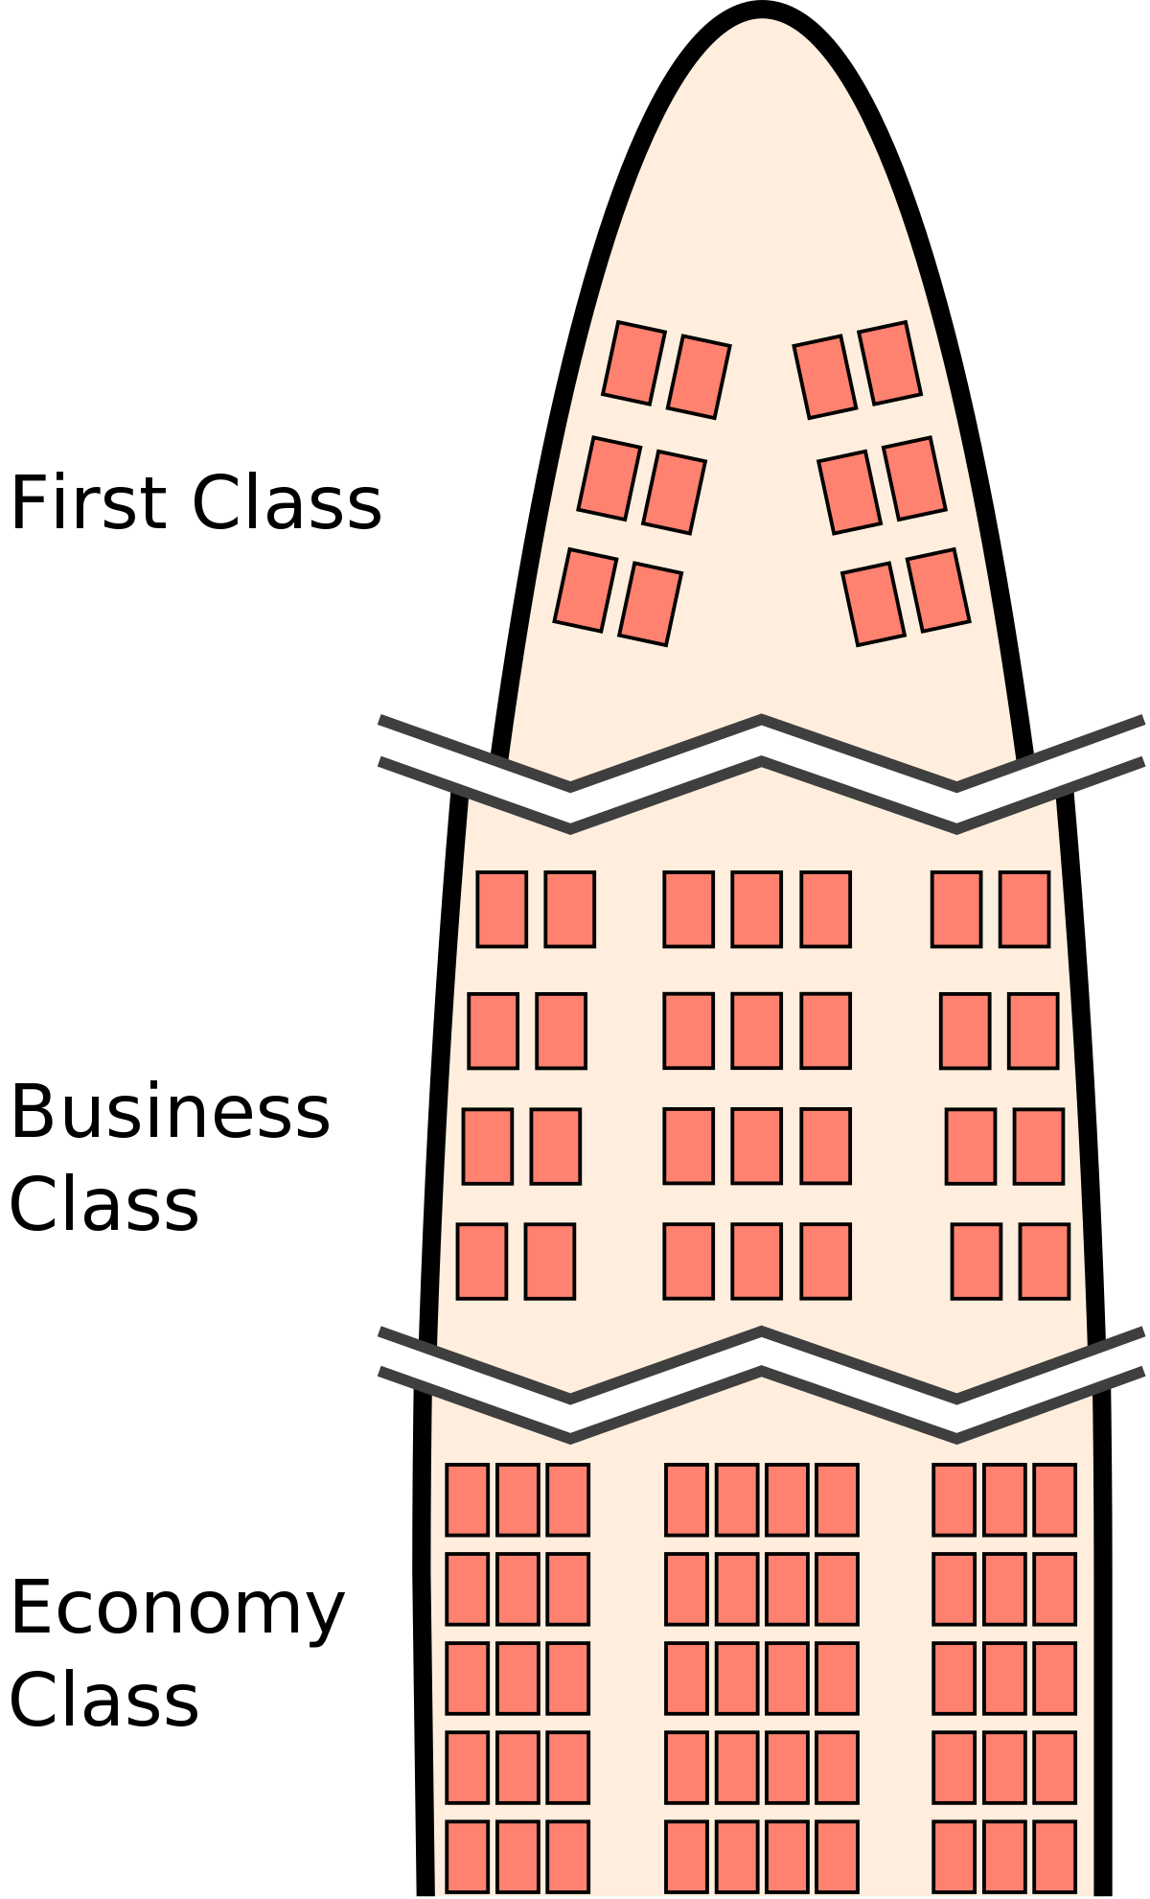
One example is the practice of tiering the pricing of a product or service to different groups of customers.
Utilitarianism
This can be seen in the airline sector, where there is a different pricing system for the first class, business class and economy class seats on airplanes.

Slide 43
Norm theory
The norm theory suggests that there are certain standards of moral behaviour that should be adhered to by the entire group.
Admissible conduct is generally outlined for a spectrum of possible situations.

Slide 44
Norm theory
For example, a corporate code of conduct or an employee handbook that supplies the framework on how employees in an organisation are expected to behave and conduct themselves in different situations.
A breach of the guidelines would usually result in disciplinary action.

Slide 45
2.5 The benefits of Business Ethics for Social Enterprises
Figure 1 Business Ethics Diagram (https://www.thehumancapitalhub.com/articles/The-Advantages-Of-Ethical-Behaviour-In-Business)

Slide 46
The value of business ethics spans further than employee loyalty and the powerhouse front that the management team presents.
Maintaining a respectable and immaculate reputation in the local community as well as internationally is of the utmost importance, both for short-term and long-term success.
If an enterprise is perceived to be operating in an unethical fashion, investors are less likely to buy into the company, nor will the enterprise be supported by a loyal customer base.

Slide 47
Prescribing a set of meticulous business ethics for the operation of an enterprise has the advantage of:
Attracting more investors to the enterprise’s business
Take the Company’s Reputation to the next level
Develop customer loyalty
Competitive advantage (customer base)
Prevent legal problems
Retain the best staff team

Slide 48
3. Corporate Social Responsibility
3.1 Defining CSR
The KEY Issues are:
Understanding where CSR fits within the business enterprise
Creating a structure that respects all aspects of CSR
Implementing business ethics from the management perspective
Ensuring good business ethics from employees
The relationship between social entrepreneurship and business ethics?

Slide 49
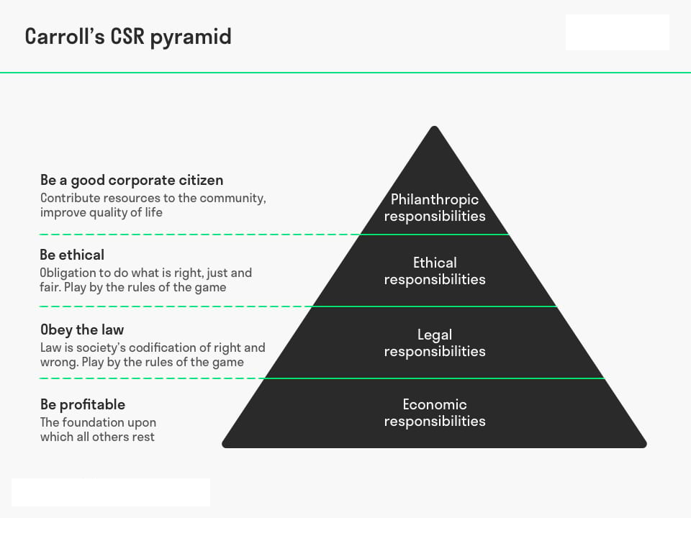
Corporate Social Responsibility

Slide 50
3.2 The four-part definitional framework for CSR
Corporate social responsibility encompasses the economic, legal, ethical, and discretionary (philanthropic) expectations that society has of organizations at a given point in time” (Carroll 1979, 1991).

Slide 51
Economic responsibilities
As a fundamental condition or requirement of existence, businesses have an economic responsibility to the society that permitted them to be created and sustained.
Society expects, indeed requires, business organizations to be able to sustain themselves and the only way this is possible is by being profitable and able to incentivize owners or shareholders to invest and have enough resources to continue in operation.

Slide 52
Legal responsibilities
Society has established the minimal ground rules under which businesses are expected to operate and function. These ground rules include laws and regulations and in effect reflect society’s view of “codified ethics” in that they articulate fundamental notions of fair business practices as established by lawmakers at federal, state and local levels.
Businesses are expected and required to comply with these laws and regulations as a condition of operating.

Slide 53
Legal responsibilities
Society’s expectations of business include their
Performing in a manner consistent with expectations of government and law
Complying with various federal, state, and local regulations
Conducting themselves as law-abiding corporate citizens
Fulfilling all their legal obligations to societal stakeholders
Providing goods and services that at least meet minimal legal requirements

Slide 55
Ethical responsibilities
In addition to what is required by laws and regulations, society expects businesses to operate and conduct their affairs in an ethical fashion.
Taking on ethical responsibilities implies that organizations will embrace those activities, norms, standards and practices that even though they are not codified into law, are expected nonetheless.

Slide 56
Ethical responsibilities
Part of the ethical expectation is that businesses will be responsive to the “spirit” of the law, not just the letter of the law.
Another aspect of the ethical expectation is that businesses will conduct their affairs in a fair and objective fashion even in those cases when laws do not provide guidance or dictate courses of action.
Thus, ethical responsibilities embrace those activities, standards, policies, and practices that are expected or prohibited by society even though they are not codified into law.

Slide 57
Ethical responsibilities
The goal of these expectations is that businesses will be responsible for and responsive to the full range of norms, standards, values, principles, and expectations that reflect and honor what consumers, employees, owners and the community regard as consistent with respect to the protection of stakeholders’ moral rights.

Slide 58
Ethical responsibilities
In meeting these ethical responsibilities, important expectations of business include their:
Performing in a manner consistent with expectations of societal mores and ethical norms
Recognizing and respecting new or evolving ethical/moral norms adopted by society and preventing ethical norms from being compromised in order to achieve business goals
Being good corporate citizens by doing what is expected morally or ethically
Recognizing that business integrity and ethical behavior go beyond mere compliance with laws and regulations (Carroll 1991)

Slide 60
Philanthropic responsibilities
Corporate philanthropy includes all forms of business giving.
Corporate philanthropy embraces business’s voluntary or discretionary activities.
Philanthropy or business giving may not be a responsibility in a literal sense, but it is normally expected by businesses today and is a part of the everyday expectations of the public.

Slide 61
Philanthropic responsibilities
The quantity and nature of these activities are voluntary or discretionary.
They are guided by business’s desire to participate in social activities that are not mandated, not required by law, and not generally expected of business in an ethical sense.
Philanthropy is one of the most important and visible elements of CSR.

Slide 63
CSR and social entrepreneurs
Social entrepreneurial organisations are not obliged to adopt the full range of CSR initiatives
They are usually small organisations
They are often non-profit oriented
They often have limited resources

Slide 64
CSR and social entrepreneurs
Social entrepreneurial organisations CAN adopt ethical behavioural standards
Management need to ensure that the prevalent culture of their organisation promotes ethical behaviour
Management need to lead by example in the adoption of ethical behavioural standards through
Transparent (ethical) processes
Safeguarding the interest of staff, customers, and society in general
Ensuring that profit (at any cost) is not the business motivator

Slide 65
CSR and social entrepreneurs
Social entrepreneurial organisations CAN adopt ethical behavioural standards
Management needs to:
monitor employee practices and behaviour
communicate and reinforce shared cultural and ethical standards
ensure that the prevalent organisational culture allows whistleblowing in the event of non-compliant behaviour
constantly reinforce the importance of ethics in the organisation

Slide 66
CSR and social entrepreneurs
Social entrepreneurship and business ethics
Social Entrepreneurs operate within an ecosystem and whether they are profit-oriented or have other societal goals, management may (and should) still adopt:
Ethical practices and behaviour
Internal and external communications to reinforce the organisational ethical standards
Clear, transparent communication in the event of non-compliant behaviour that does not lead to repercussions
Reinforcement of the importance of ethics in the organisation at every opportunity

Slide 67
Key take-away points
Understand the three concepts of what defines a social entrepreneur, namely the key objective, the treatment of profits and the adoption of appropriate CSR / ethical principles
The challenges that organisations face in the treatment of profits and relationship with their stakeholders
The challenges to adopt an appropriate CSR strategy, and understanding of the ethical principles of behaviour that guide the organisation.

Slide 68
Reflection/Self assessment
1) How would you implement business ethics if you were a manager?
2) How would you ensure good business ethics from your employees?
3) How does social entrepreneurship relate to business ethics?

Slide 69
Thanks!
https://www.beyond-capital.eu/
Please keep this slide for attribution
INSERT YOUR WEBSITE HERE
Please, fill out this quick assessment to help us improve the module!
INSERT QR CODE HERE

