Slide 1
Module 2 - Creating the strategic plan and building a finance function for early stage enterprises: need analysis, financial planning, and management
GEINNOVA & EXEO LAB

Slide 2
Working Units
Mapping the economic and financial processes of social enterprise
Social enterprise financial planning and management and
innovation and digitisation of financial processes

Slide 3
Methodology and learning outcomes
Aim: | Performance criteria:
Provide social entrepreneurs with the skills to create a business plan and to manage financial processes also through innovative and digital tools | The ability to understand the concept of planning a strategy and financial resources to allocate according to objectives previously set through an innovative management model

Slide 4
Methodology - EQF
Knowledge: | Skills: | Competences:
- Learn how to plan a business and identify goals - Know exactly how to achieve objectives set - Understand the differences between the various types of financial management -Know the exact tools that make up finance management | - To define and focus on business ideas, strategies and vision - Identify potential pitfalls as well as strengths -Planning strategies in both the short and long term -To acquire a concrete entrepreneurial vision that can guarantee the success of the social enterprise | - Take specific steps necessary to make business ideas succeed achieving short-term and long-term objectives - Management is better-equipped to handle uncertainty and to focus on strong points -Have control over the budget that makes the company acquire wealth

Slide 5
Methodology - EQF
Knowledge: | Skills: | Competences:
- Understand how to effectively use the resources available within the organisation -Know how to calculate cash flows, construct a balance sheet and control the company's profit and loss. -Know the digital tools for financial processes | - Plan strategically the necessary financial resources for the enterprise - Market and feasibility analysis -Adapt to changing situations of the social enterprise and the context in which it operates through problem solving skills -Manage cash and work flows efficiently -Identify potential opportunities in digitised financial management | - Allocating resources in a way that will help achieve strategic objectives - Critical, logical and systematic thinking -Minimise risks of failure by adapting diversified methods and strategies -Create social value by pursuing common interests through an innovative management model

Slide 6
Mapping the economic and financial processes of social enterprise
THE BUSINESS PLANNING PROCESS
1.1 The purpose of planning and management tools
1.2 Planning the agenda taking into consideration priorities and internal needs
1.3 Articulating the mission of the social enterprise
1.4 Outlining the specific actions to achieve goals and objectives
1.5 Establishing targets for planning, measuring and improving performance
1.6 Eco-systems of support for social enterprise: maintaining effective communication with stakeholders, funders or investors, community, board, employees and volunteers (network)
1.7 What is a business plan
THE ECONOMIC BALANCE OF THE SOCIAL ENTERPRISE
2.1 Characteristics and management of the financial objectives
2.2 Planning the necessary resources, costs and revenues
Index

Slide 7
Social enterprise financial planning and management
and
innovation and digitisation of financial processes
INTRODUCTION TO FINANCIAL MANAGEMENT
3.1 What is financial management
3.2 Objectives
3.3 Elements of financial management
COMPONENTS OF FINANCIAL MANAGEMENT - CONSTRUCTING, READING AND UNDERSTANDING
4.1 The balance sheet
4.2 The profit and loss statements
4.3 The cash flow statement
4.4 The importance of budget indicators for the above statements for control and management purposes
AUTOMATION AND FINANCIAL MANAGEMENT
5.1 Big Data for real-time management
5.2 Tool tips
Index

Slide 8
The importance of planning
THE BUSINESS PLANNING PROCESS
1.1 The purpose of planning and management tools
One of the major causes of the success of businesses is the definition of their own objectives. To achieve success it is necessary to:
Know clearly what you are looking for;
Develop a plan to achieve it;
Concentrate, work and strive to reach it

Slide 9
In order to define the objectives properly, they must meet a series of characteristics. The objectives should be SMART
Specific – detailed, focused and well defined
Measurable – a measure to monitor progress
Achievable (or agreed)– the necessary resources are available
Relevant (or realistic) – clear understanding of how the objective, aligned with the overall strategy of the organization, might be reached
Time bound – a limited amount of time should be established

Slide 10
Work methodology of management by objectives
Planning is the function of management that involves setting objectives and determining the course of action for achieving those objectives.
Planning requires managers to be aware of environmental conditions facing their organization and forecast future conditions.

Slide 11
There are different types of plans and planning:
Strategic planning involves analyzing competitive opportunities and threats, as well as the strengths and weaknesses of the organization. It has a long time frame;
Tactical planning is intermediate-range (one to three years) planning that is designed to develop relatively concrete and specific means to implement the strategic plan;
Operational planning is short-range (less than a year) planning that is designed to develop specific action steps that support the strategic and tactical plans.

Slide 12
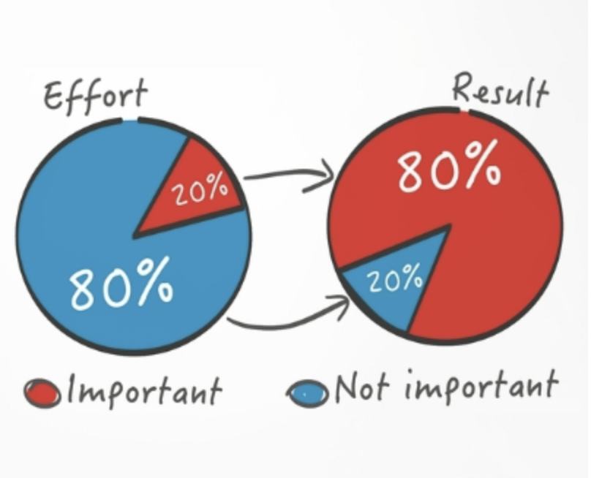
Time management
The 80/20 rule​​
Approximately 20 percent of your efforts produce 80 percent of the results
Learning to recognize and then focus on that 20 percent is the key to make the most effective use of your time.
Eat that frog first: start with a task that seems most complex and the hardest;
Keep your eyes on the main goal: set one big goal and work on it all the time;
Identify what distracts you the most: identify what distracts you the most to keep it away.

Slide 13
Management tools
SimpleMind allows users to create mind maps to easily establish connections between ideas;
Evernote allows users to organize all their information by filing notes;
Stratpad allows users to create a business plan and financial projections explained step by step;
Anfix allows users to carry out the accounting and billing of their business;
Skype allows instant communication;
LinkedIn is the most widespread professional network in the world;
Google Analytics allows to know and analyze the traffic of your website and the trends of the network

Slide 14
1.2 Planning the agenda taking into consideration priorities and internal needs
When planning the agenda it is very important to take into consideration everything that needs attention, all of your tasks and internal needs
You can break the tasks down into three different priority levels:
Critical priorities are time sensitive and high value. These include tasks dealing with crises or strict client deadlines. High value tasks that are not time sensitive should be considered high priorities;
Medium priorities can be time sensitive but not high in value. Meetings, email communications, and project organizing can fall into this category;
Low priority tasks are the ones that are not time sensitive and do not have high value.

Slide 15
1.3 Articulating the mission of the social enterprise
Your social enterprise needs to have a clearly defined brand and business brief which communicates what it does, how it does it and why it does it.
A social enterprise is distinguished from a conventional business because it is established to tackle a problem or promote a cause as its primary intention.
Tackling a problem or a challenge becomes the organizations’ ‘social mission’.

Slide 16
The mission statement
The mission statement is the barebones, straightforward idea of why and what you are going to accomplish.
Social enterprises often come down to the question ‘Why?’ - the core of your social enterprise, the values it wants to pursue. A vision really gets to the ‘Why’ of your organization.
The “What”, is what you have designated this business to do, it responds to the question ‘’ what will you do to make the difference?’’. The what states what the goal of the organization is.
How we go about establishing the mission statement is by filtering down the objectives into a single sentence that encompasses the entire vision. Your mission statement has to be short, specific and measurable.
In social enterprises, you can also have it described as your ‘social mission’.

Slide 17
1.4 Outlining the specific actions to achieve goals and objectives
Once you have decided the mission statement for your cause, the next step will be determining your how. It informs how you plan to deliver the change you believe is required
Then, it’s time to examine who will be doing this
Once you’ve delegated the task responsibility to someone, ensure you detail accountability. By doing this you make clear what the goals and parameters are
After you’ve developed your accountability, you’ll want to include enough detail to ensure fully understanding of what the scope, limit and purpose of the assignment is.
You are be ready to distribute the outline for the action to the designated people with full confidence.

Slide 18
1.5 Establishing targets for planning, measuring and improving performance
Establishing targets for planning, measuring and improving performance, is incredibly important to understand where your organization is succeeding, progressing, receding and failing.
You have to Identify the key areas that drive your business performance and find a way to measure them.
This type of measurement unit is referred to as a
key performance indicator (KPI)
The two key attributes of a KPI are:
quantifiability (i.e. you must be able to reduce it to a number)
It directly captures a key business driver.

Slide 19
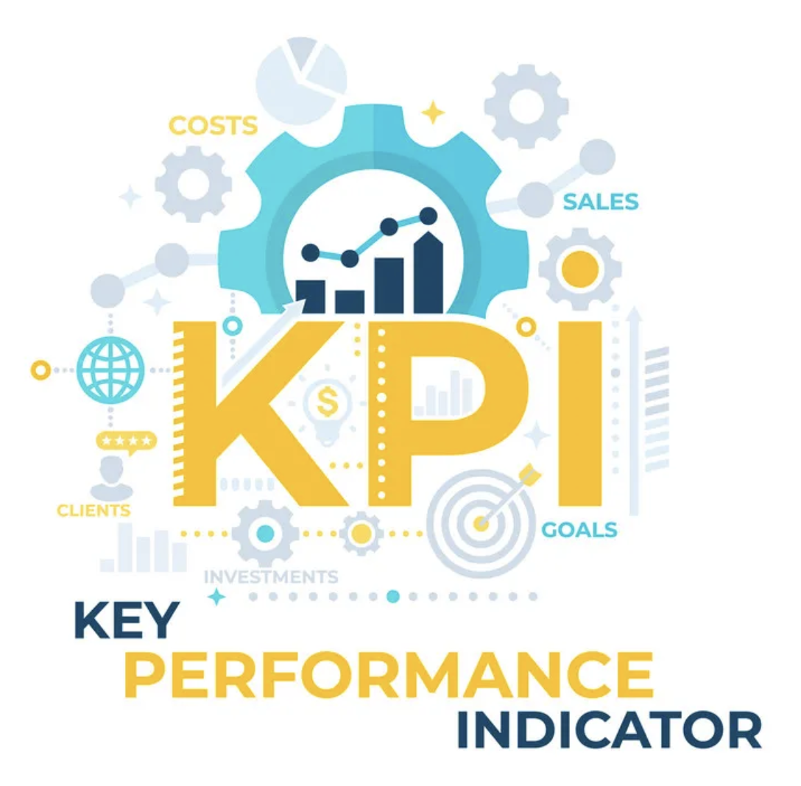
KPIs
KPIs are at the heart of any system of performance measurement and target-setting.
There are a number of key criteria that your KPIs should meet:
they should be as closely linked as possible to the top-level goals of your business;
they need to be quantifiable;
they should relate to aspects of the business over which you have control.
Moreover, there are two main ways in which you can drive future improvements using your KPIs to:
spot potential problems or opportunities;
set targets for departments and employees.

Slide 20
1.6 Eco-systems of support for social enterprises
Social entrepreneur's goal is creating value for society.
Social support organizations are characterized by a willingness to create economically sustainable models that seek to increase their impact.
Identifying the eco-systems of support is even more crucial for social enterprises in order to achieve medium and long-term sustainability

Slide 21
Common ways to communicate
with stakeholders
Periodic meetings
Press releases
Websites and social media
Fundraising events
Participation in collaborative project teams and task forces

Slide 22
1.7 Business plan
The business plan should outline your business strategy and key goals, including:
financial projections,
marketing,
operational plans.
Having clear the long-term goals helps to take steps towards them in the day-to-day running of the business.
A document providing a description and overview of the enterprise

Slide 23
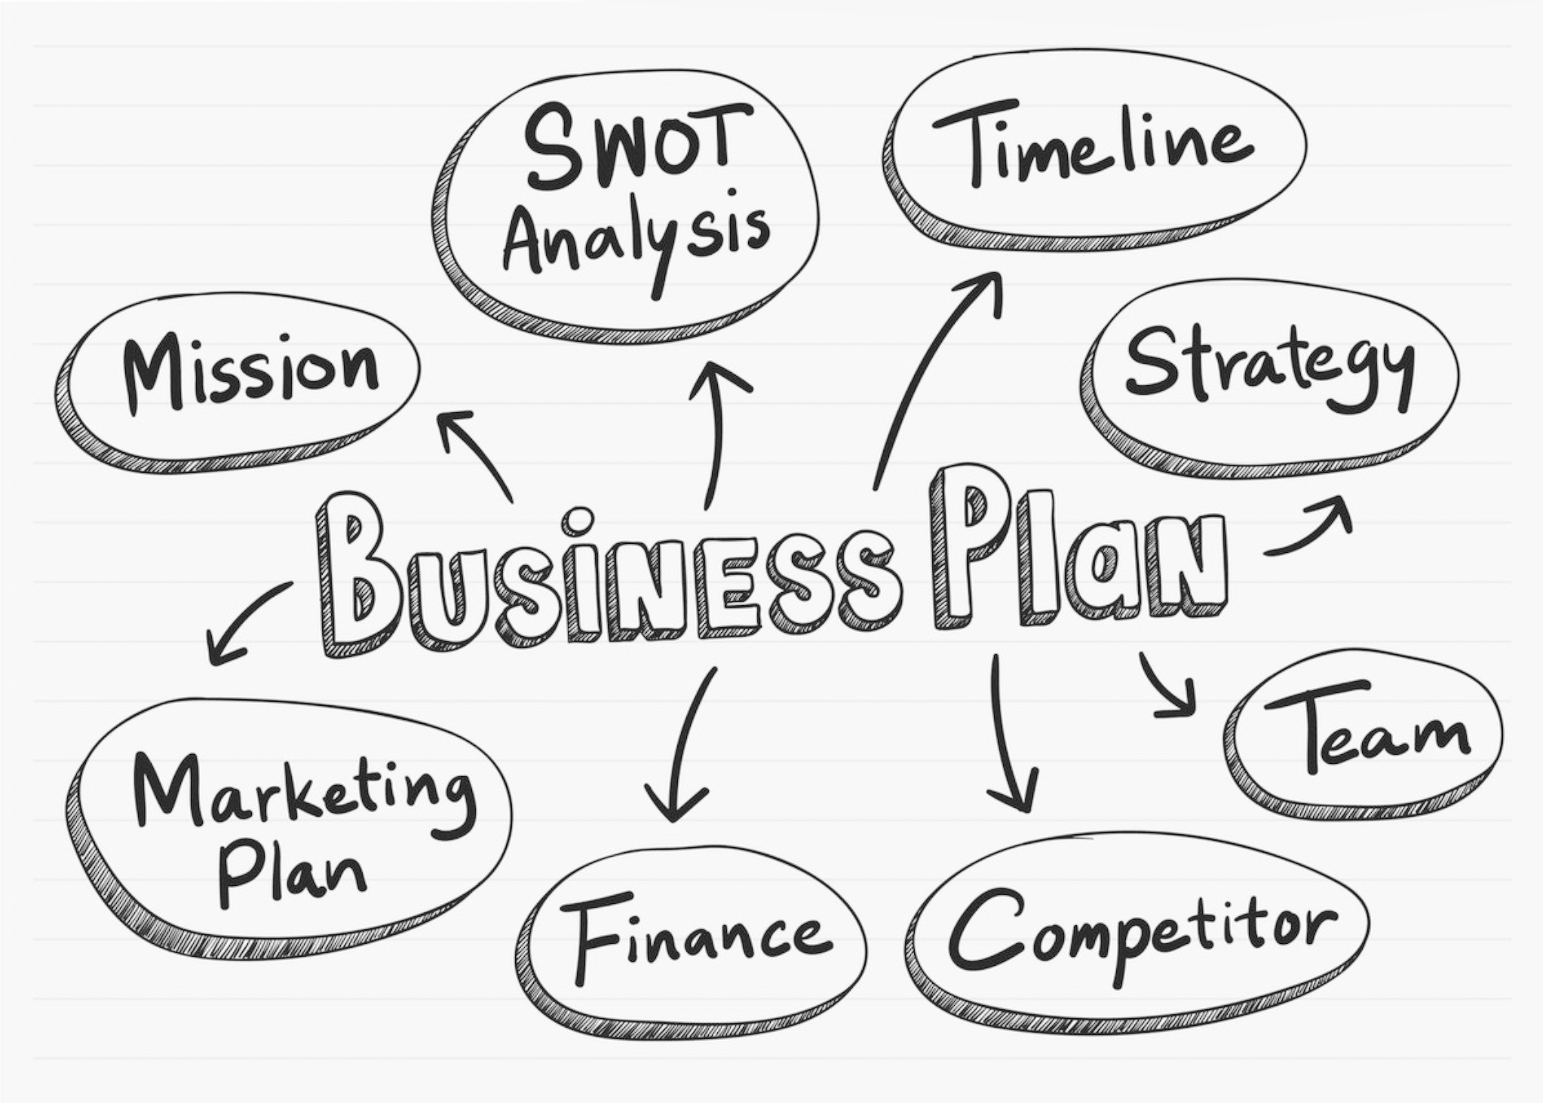
The business plan should also:
act as a benchmark for the performance of your company,
set out how you expect your business to perform in the coming years and how you will overcome any potential obstacles,
be a useful tool to:
focus and develop ideas;
identify your business priorities;
think through options and opportunities
help convince banks and potential investors to support and fund your business,
help attract more talents and resources.

Slide 24
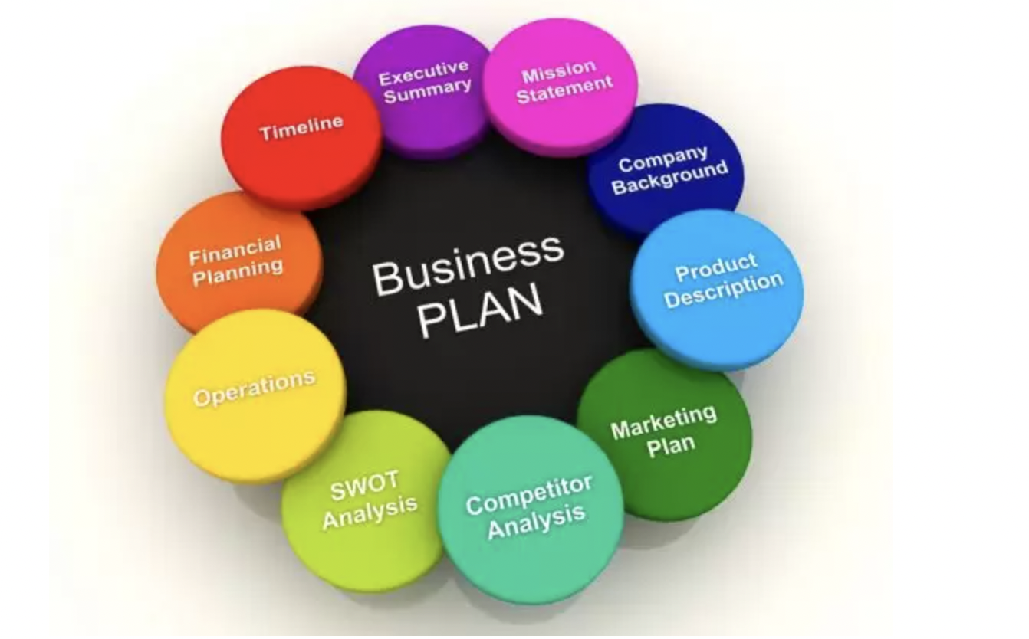
Key sections of a business plan
What should your business plan include?
Executive summary
A business description
The business opportunity
Market target
Details of market strategies
Competitor analysis
A design and development plan of your products and services
Information about your operations and management plan
Financial information, planning and factors
A business plan should be regularly revisited and updated
This makes it a very useful tool for measuring success or supporting you in moving towards a new business direction

Slide 25
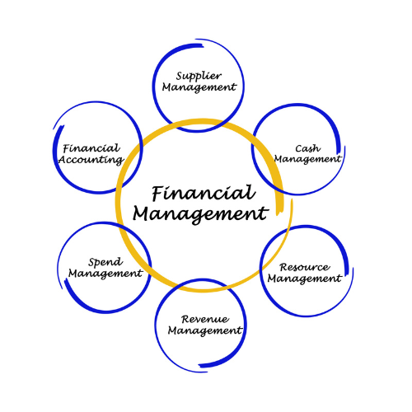
2.1 Characteristics and management of the
financial objectives
2. ECONOMIC
BALANCE
Analyzing in more depth the last section of the business plan that is about financial information, it is important to highlight that
the main goals of the management of financial objectives are to manage the organization’s finances in compliance with legal requirements, creating financial discipline and enhancing the organization’s financial health.
These objectives help financial managers determine how much to invest, how much to save and ensure business success.

Slide 26
The finance team plays a critical role in any organization. It is responsible for:
making important decisions through profit and loss analysis, financial forecasting and ratio analysis;
utilizing available resources and ensuring that they fulfill the organization’s needs;
ensuring that the organization makes decisions after consideration of available funds and potential risks in the future.

Slide 27
The term ‘resources’ includes everything that might impact your ability to stay in business:
equipment for manufacturing products or doing the work,
machinery,
raw materials,
vehicles,
staff members...
2.2 Planning the necessary resources, costs and revenues

Slide 28
Resource plan
Resource planning is a strategic approach to ensuring resources are used in the most effective way, to gain more control over your outgoings and cash flow.
A resource plan identifies, organizes and lists the resources required to complete a project. It acts as a blueprint to help ensure projects and work are executed on time and on budget.

Slide 29
Resource planning helps ensure:
Maximum resource utilization: strategic focus on maximizing resource utilization;
On-time delivery: delivering projects on schedule helps build customer satisfaction and loyalty;
On-budget delivery: overspending can cause project cancellations, missed revenue, and reduced profitability.

Slide 30
Resource planning helps ensure:
Predictable project timeline: available resources are strictly connected to the amount of time required to perform tasks;
Improved tasks flow: the right people work on the right tasks at the right time;
More accurate estimates: this can also help executives estimate when projects will begin to impact revenue, costs and profitability.

Slide 31
3. INTRODUCTION TO
FINANCIAL MANAGEMENT
3.1 What is financial management
3.2 Objective of financial management
3.3 Elements of financial management

Slide 32
What is financial management?
“Financial management is the activity concerned with planning, raising, controlling and administering of funds used in the business.”
Guthman and Dougal
FM is the sub-unit of management that focuses on generation of financial information that can be used to improve decision-making.

Slide 33
OBJECTIVE OF
FINANCIAL MANAGEMENT
High Efficience
FM tries to increase the efficiency of all business departments
Reduce Risks
Financial managers have to avoid high-risk situations and take calculated risks

Slide 34
OBJECTIVE OF
FINANCIAL MANAGEMENT
Business Survival
Entrepreneur needs to maintain management control because the survival of the organization is a primary goal
Balanced Structure
Financial managers have to prepare a firm capital structure that takes into account all sources of capital

Slide 35
Elements of financial management
FM consists of three key elements:
Financial planning - It is a way of calculating the capital needed and allocating resources appropriately
Financial control - It is about establishing appropriate KIPs to ensure that the organization works towards its goals
Financial decision-making - It is about entrepreneurs that have to decide on financing, resource allocation, profit distribution and much more.

Slide 36
4. COMPONENTS OF FINANCIAL MANAGEMENT: CONSTRUCTING, READING AND UNDERSTANDING
4.1 The balance sheet
4.2 The profit and loss statement
4.3 The cash flow
4.4 Budget indicators

Slide 37
To understand how to approach the world of financial management, in the sense of control of an organisation's funds, it is first necessary that every enterprise to have three basic documents:
The Balance Sheet
The Profit And Loss Statements
The Cash Flow

Slide 38
THE BALANCE SHEET
The accounting balance sheet is a picture of the company's financial situation, through which it is possible to analyze the financial position. With this paper anyone can see what the enterprise owns, how many debts the organization has and how much has been invested. The financial situation is the main point of the balance sheet, but what is it? It is simply the ability to face debts. It is different, as we will see, from the economic situation.
In other words, the balance sheet shows the company’s total assets and how these assets are financed, through either debt or equity, and is useful for doing both internal and external analysis.

Slide 39
<< Balance sheets helps to understand if an organization is succeeding or struggling by analyzing the liquidity situation >>
Internal Analysis: | External Analysis:
With the internal analysis is possible to understand: • if the organization is able to meet future expenses or handle a market shock; • trends in assets and liabilities to make sure the organization is functioning properly; • problem areas. | It helps investors and stakeholders to: evaluate the company, to see its financial position, the current available resources, and all the financing arrangements. For investors, this can help them to understand whether it would be worth to invest in that company.

Slide 40
The balance sheet is based on this essential equation:
Assets = Liabilities + Equity
ASSET: what the business owns
LIABILITY: what the business owes
SHAREHOLDER’S EQUITY: how much has been invested into the business

Slide 41
DIFFERENCES BETWEEN TRADITIONAL AND SOCIAL ENTERPRISE BALANCE SHEETS
Social enterprises are required to prepare the balance sheet at the end of the fiscal year. However, this document has some differences from the traditional one. The status of "social enterprise" can be acquired by any economic entity. The important thing is that it carries out on a stable and lasting basis an economic activity (non-profit) based on the general interest, and for civic, solidarity and socially useful purposes.
For this reason, the social enterprise is labor intensive rather than capital intensive.

Slide 42
THE PROFIT AND LOSS STATEMENT
The profit and loss account provides the financial results of a social enterprise's operations over a period. The task of the profit and loss account is to describe how much money the enterprise earned during its business and what costs it incurred to generate this income. So, the P&L statement shows a company’s ability to generate sales, manage expenses, and create profits.

Slide 43
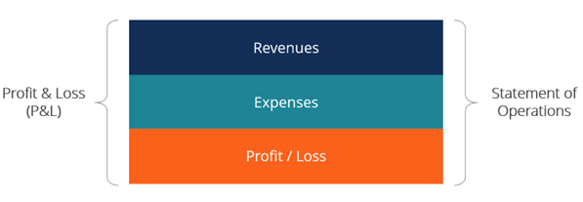
The main categories that can be identified in the profit and loss statement are:
Revenues: these consist of sales of products or services and recurring income that is not directly related to business activities;
Earnings: these include one-time transactions;
Expenses: these include all operating costs, such as employee salaries, sales commissions, taxes, and administrative fees;
Losses: As with earnings, these are one-time costs or events that represent a loss for the organization
Net income: Also called “bottom line”, this is what the income statement calculates. To calculate net income, all revenues and earnings are added together and expenses and losses are subtracted.

Slide 44
Why is the profit and loss account important?
The profit and loss statement provides an analysis of the overview and helps companies identify where they need to refine their business strategy. Comparing different funds statements over the years allows companies to:
Understand how income and expenses are accumulating over time: Profit and loss accounts can help you understand where costs are coming from, how to cut them and how to maximise net income.
Planning the future: New or start-up companies include a profit and loss statement as part of the business plan.
Finalise taxes: Established companies that prepare income statements can use the information in profit and loss reports to complete their taxes.

Slide 45
THE CASH FLOW
It is a summary of income and outflow, detailing how cash flows into and out of the organization, and is normally recorded in monthly bands.
Business management should aim for a positive cash flow. With the right liquidity, in fact, the organization is able to pay taxes, suppliers and other creditors, as well as employees, without problems

Slide 46
How is profit and loss calculated?
You can calculate profit and loss by subtracting total expenses from revenue in a given period following this equation:
Profit and loss / Net profit = Revenue - Expenses

Slide 47
What is the difference between an operating budget and a balance sheet?
Many people confuse financial statements with balance sheets. Although both provide historical financial data, they approach this information from two different perspectives:
Balance sheet: | Cash flow statement:
A balance sheet illustrates the value of the company. This means that it reviews the company's assets (what the organization owns), liabilities (loans or money owed to persons or certain entities) and equity (value of shares). | The cash flow statement shows the change in profitability over time. It displays the performance of the organization over a given period and the balance sheet shows the impact of that performance on the value of the company.

Slide 48
BUDGET INDICATORS
Monitoring the company's performance level is a primary condition for its ongoing growth and expansion. Moreover, a performance evaluation based exclusively on numerical data is certainly insufficient. Taking into account quantitative parameters alone offers a limited insight into the internal world of the company, allowing one to focus on how to make it the best possible competitor. For these reasons, the otherwise insufficient indicators of a strict economic-financial type are now supplemented by other so-called Key.

Slide 49
The main budget indicators are:
Return on investment (ROI) = (Net Profit / Cost of Investment) x 100
Return on equity (ROE) = (Net Income / Shareholder's Equity) x 100
Return on sales (ROS) = Operating Profit / Net Sales
Return on assets (ROA) = Net Income / Total Assets

Slide 50
5. AUTOMATION AND FINANCIAL MANAGEMENT
5.1 Big data for real-time management
5.2 Tool tips

Slide 51
Big data for real time management
One of the most important assets of an organization is data and its agile management. In order to keep up with modern technology a company can receive numerous advantages in the FM of real-time data.
The budget analysis and business plan software allow entrepreneur and social entrepreneur to make assessments based on indices related to:
economic situation
financial situation
balance sheet situation

Slide 52
Benefits
The use of digital tools can only bring benefits to organisations that take advantage of them, including:
Quick time
Digital tools speed up manual tasks
Few errors
Digital tools minimise the possibility of manual errors
Good use of data
Digital tools specifically analyse each piece of data provided to them

Slide 53
Tool tips
There are numerous online tools (software) that can be used.
Choice of software may depend on:
-needs;
-requirements;
-costs.

Slide 54
Tool tips - Examples
Software: | Pros:
Cube | Intuitive spreadsheet integrations with Excel and Google Sheets; Get smarter, faster insights into your financial data in real time.
Anaplan | Ability to connect to any number of planning streams via a single dashboard; Intuitive user interface with a good deal of customisation; Detailed reports can be obtained in real time with just a few clicks.

Slide 55
Tool tips - Examples
Software: | Pros:
Vena | Uses Excel Knowledgeable support staff on-hand and online training materials; Flexible reporting; Cloud-based with mobile support.
Planful | Very flexible and easy-to-use budgeting, forecasting and cash flow analysis models; Capable of handling complex reporting needs; Excel-like interface.

Slide 56
Tool tips - Examples
Software: | Pros:
Adaptive | Scenario planning and forecasting functions support visualisation of future cash flows.

Slide 57
Key take-away points
You need to understand the business planning process, with the construction and understanding of the social budget and how to manage resources, costs and revenues;
You need to understand what financial management is, its objectives and distinguishing features;
You need to understand tools for a real time management of your business plan in order to have a more detailed knowledge of the management of your own assets.

Slide 58
Reflection/ Self-assessment
1) How would you build your business plan if you were a social entrepreneur manager?
2) What are the key social finance objectives to keep in mind if you are an entrepreneur?
3) How can digital tools benefit the financial management of social enterprises?

Slide 59
Thanks!
https://www.beyond-capital.eu/
Please keep this slide for attribution
www.cbe.be
INSERT YOUR WEBSITE HERE
Please, fill out this quick assessment to help us improve the module!
INSERT QR CODE HERE

