Slide 1
Module 1 - Social enterprises, management and operation
COOPÉRATION BANCAIRE POUR L’EUROPE – GEIE
MALTESE ITALIAN CHAMBER of COMMERCE

Slide 2
Working Units
What is a social enterprise?
B-Corp and how to get a certification
Mapping of legislation in different countries on social enterprises
How to build or access a network and interact with your stakeholders
Synergy and balance between social and economic objectives - How to market your product
How to measure social impact
Best case - Interview with Close the Gap

Slide 3
Methodology – EQF Work Unit 1
Knowledge: | Skills: | Competences:
Knowledge for: Definition of a Social enterprise Understand what a Benefit Corporation is Having an overview of the European legislative system of social enterprises | Technical and specific skills for: Being able to understand what a Social enterprise does Being able to understand the difference between Benefit Corporations | Competences for: Learning to recognize a Social enterprise Making your company a Benefit Coroporation Succesfully acquire a B-Corp certificate

Slide 4
Methodology – EQF Work Unit 1
Knowledge: | Skills: | Competences:
Knowledge for: Connecting individuals and organization from across different communities and social enterprises Finding the right balance between social and economic dimension within social enterprises | Technical and specific skills for: Being able to get a B.Corp certificate Knowing the requirement essential for the creation of the social and economic dimension Knowing how to create a multi-stakeholders system | Competences for: Finding the right legislation in a specific country to define your social enterprise Creating a network and interacting with stakeholders

Slide 5
Methodology – EQF Work Unit 1
Knowledge: | Skills: | Competences:
Knowledge for: Knowing how to measure social impact | Technical and specific skills for: Knowing how to map the European legislative system of social enterprises | Competences for: Knowing how to exceed the social and economic dualism Being able to understand the role of stakeholders and how to create an enterprises socially valuable

Slide 6
Social enterprises, management and operation
1. What is a social enterprise?
1.1. Definition
1.2. Context and Background
1.3. Social enterprises nowadays
2. B-Corp and how to get a certification
2.1. What are Benefit Corporations?
2.2. What are B-Corps?
2.3. Benefit Corporations as legal subjects
3. Mapping of legislation in different countries on social enterprises
3.1. Spain
3.2. Italy
3.3. Germany
3.4. Cyprus
3.5. Malta
3.6. Belgium
Index

Slide 7
Social enterprises, management and operation
4. How to build or access a network and interact with your stakeholders
4.1. Why is social enterprise networking important?
4.2. How to build a network
4.3. How to interact with stakeholders
4.4. Advantages of a multi-stakeholder system
5. Synergy and balance between social and economic objectives - How to market your product
5.1. Economic and social dualism
5.2. Economic dimension
5.3. Social dimension
5.4. Social marketing
6. How to measure social impact
6.1. Purpose of measurement
6.2. Stakeholders
6.3. Impact value chain
6.4. Approach to measurement
7. Best case - Interview with Close the Gap
Index

Slide 9
Social enterprises
Social enterprises are operators in the social economy whose main objective is to have a social impact rather than make a profit for their owners / shareholders.
WHAT IS A SOCIAL ENTERPRISE?
1.1 Definition

Slide 10
Definition of Social enterprise
It operates by providing goods and services for the market in an entrepreneurial and innovative fashion and uses its profits primarily to achieve social objectives.
It is managed in an open and responsible manner and, in particular, involves employees, consumers and stakeholders affected by its commercial activities.
Social enterprises focus on achieving wider social, environmental or community objectives.

Slide 11
Definition of Social enterprise
The concept of social enterprise differs between countries.
The European Commission employs this term to cover the different types of business:
Business whose social or societal objective of the common good is the reason for the commercial activity, often in the form of a high level of social innovation
Business whose profits are mainly reinvested to achieve this social objective
Business where the method of organization or the ownership system reflects the enterprise's mission, using democratic or participatory principles or focusing on social justice

Slide 12
Definition of Social enterprise
Social enterprises mainly operate in 4 fields, also defined as societal goals:
Work integration - training and integration of people with disabilities and unemployed people
Personal social services - health, well-being and medical care, professional training, education, health services, childcare services, services for elderly people, or aid for disadvantaged people
Local development of disadvantaged areas - social enterprises in remote rural areas, neighborhood development/rehabilitation schemes in urban areas, development aid and development cooperation with third countries
Other - including recycling, environmental protection, sports, arts, culture or historical preservation, science, research and innovation, consumer protection and amateur sports

Slide 13
Definition of Social enterprise
Social enterprises combine:
Societal goals
Entrepreneurial Spirit

Slide 14
1.2 Context and Background
The historical context and background of social enterprises can date back to the Medieval ages in some cases as Germany, when nonprofit organizations already supplied social services.
In fact, most social enterprises have their roots in the tradition of associations, mutual aid societies and cooperative and voluntary engagement that preceded the creation of the contemporary state bodies.
Nevertheless, in other countries the history and origin of social enterprises is closely linked to the characteristics and evolution of their welfare systems.

Slide 15
1.3 Social enterprises nowadays
Entrepreneurial /economic dimension
The social enterprise is an increasingly widespread phenomenon with great potential, which is still far from being fully harnessed.
Social enterprises have a significant impact on income, employment and welfare.
The potential of the social enterprise results from its peculiar features - as stated in the previous slides: thus, the definition of social enterprise is far from being “neutral” and has important implications for policy.

Slide 17
2. B-Corp and how to get a certification
A benefit corporation is a business entity with a dual purpose: making a profit and promoting the public good. While a for-profit corporation's sole purpose is to make a profit for its shareholders, and a nonprofit's purpose is to fulfill its mission or support its beneficiaries (such as promoting environmental sustainability or serving low-income individuals), a benefit corporation engages in both.
2.1 What are Benefit Corporations?

Slide 18
To be eligible as a benefit corporation, your company must have a public benefit purpose and commit to creating annual reports that show your progress towards your stated mission. Your formation documents must include a statement of one or more public benefit purposes, such as:
serving low-income individuals or communities
environmental sustainability
promotion of arts or music
sharing profits with charities
contributions to scientific research
advancement of public education, or
a general public benefit purpose

Slide 19
2.2 What are B-Corps?
Certified B-Corps are those that work “toward reduced inequality, lower levels of poverty, a healthier environment, stronger communities, and the creation of more high-quality jobs with dignity and purpose”
(https://bcorporation.eu/)
Business and profits are not the purpose of Benefit Corporations, they are instead the means to a greater end, that is the well-being of their employees, the communities and the environment around them.
B Corps balance the interests of shareholders with the interests of workers, customers, communities and the environment.

Slide 20
The b-corps family
The B-Corp movement was born in the USA through the work of B-Lab, an NGO whose mission is to spread a new international culture based on the social impact and responsibility of any business around the world.
B Corps are an extension of the benefit corporation concept.

Slide 21
B-impact assessment
“There are more than 3.400 Certified B-Corps in the world, distributed in 71 Countries.
More than 120.000 Companies worldwide have undergone the B Impact Assessment “
LoreB Lab developed the B-Impact Assessment, which is available for free for any company interested in measuring its level of commitment towards communities and environment. Once a company passes the Assessment with more than 80/200 points, it can apply for the Certification process.

Slide 22
2.3 Benefit corporations as legal subjects
Following the global relevance of the B-Corp movement many governments are developing their own legislation in order to validate B-Corporations as legal subjects.
Benefit Corporations have acquired legal status in the following countries:
Italy (“società Benefit”)
France
Colombia
Ecuador
USA (36 States)
The legalization process is furthermore taking place in 5 new US Countries and 12 further Countries around the world.

Slide 23
Context
On January 1st 2016, Italy became the first European state and the second country in the world creating a new legal status for companies, called “Società Benefit” (in the US, Benefit Corporation). A Società Benefit is a company which combines the goal of profit with the purpose of creating a positive impact for society and the environment and which operates in a transparent, responsible and sustainable way.

Slide 24
How to become a Certified B- Corporation?
to become a B-Corporation you have to take the test (for free): https://bimpactassessment.net/
if your grade is 80/200 or higher, validate your results with B- Lab;
Subscribe the C-Corp Declaration of Interdependence!

Slide 26
3.1 Legislation on Social enterprises around Europe
3. Mapping of legislation in different countries on social enterprises
1. Legislation on Social enterprises around Europe
Spain
Italy
Germany
Cyprus
Malta
Belgium

Slide 27
Mapping of legislation in different countries on social enterprises
Social enterprises are strictly related to the countries stories and tradition, every country has a different approach to this kind of activity, due to cultural and legal differences.
In the following slides it is illustrated how different countries define and regulate social enterprises.

Slide 28
3.1 Spain
Spain’s emerging social enterprise ecosystem shows a contrast between institutionalisation and innovation
Social enterprise networks are considered for their double mission:
to defend the collective and professional interests of social enterprises, and
to promote and enact all types of services that serve the interests and needs of social enterprises.
Two approaches exist in relation to traditional forms of social economy and new business models that balance economic and social aims:
One understands social enterprise as part of the social economy
The other considers social enterprise as a new field
The Law 5/2011 on the Social Economy establishes the legal framework

Slide 29
Spain
Social initiative cooperatives (CIS) - Law 27/1999
Law 5/2011 on the Social Economy as the legal framework for Spanish social enterprises
Special employment centres (CEE) - Law 13/1982 (non-profit qualification in Law 9/2017)
Employment integration enterprises (EI) - Law 44/2007
Timeline

Slide 30
3.2 Italy
The history of social enterprises in Italy is closely linked to the characteristics and evolution of its welfare system.
It spans nearly 40 years, encompassing diverse trends across the various organisational types that make up the social enterprise spectrum. These are:
Social cooperatives,
Entrepreneurial associations and foundations,
Limited liability companies,
Traditional cooperatives and mutual aid societies.
Key changes have recently been introduced by Law 106/2016 reforming the "third sector" and Legislative Decrees 117/2017 and 112/2017

Slide 31
Italy
2017: Legislative Decree 112/2017 (revision of the previous legislation on SEs) Repealed Legislative Decree 155/2006 and introduced a new discipline, which provides for partial distribution constraint, more inclusive governance, enlargement of the sectors of activity and exemption from corporate tax on retained profits.
1991- 2000 Law 266/1991 on Voluntary Organisations, Legislative Decree 460/1997 on ONLUS, Law 383/200 on Social Promotion Associations Progressive recognition of the potential of associations and foundations to run economic activities that are consistent with their institutional activities.
1988: Constitutional Court ruling 396.
Established unconstitutionality of Law 6972/1890 (Crispi Law) providing that welfare activities had to be organised exclusively by public entities.
2012- 2013 Legislative Decree 179/2012 and Decree of the Ministry of Economic Development of 6 March 2013. Established that mutual aid societies must register in the SE section at the Companies Register
1991 Law 381 (on social cooperatives). Acknowledged a new cooperative form explicitly aimed at pursuing the general interest of the community (A-type provides social, health and educational services; B-type integrates vulnerable persons into work).
2005- 2006 Law 118/2005 and Legislative Decree 155/2006 (on SEs). Allowed the establishment of SEs under a plurality of legal forms (association, foundation, cooperative, shareholder company) and enlarged the set of activities of SEs. Introduced a total distribution constraint and asset lock
2016 Law 106/2016 (Reform of the Third Sector, SE and Universal Civil Service). Re-launched the SE by introducing a new qualification. Established its non-profit purpose and placed the social enterprise within the third sector. Favours the development of social enterprises other than social cooperatives.
Timeline

Slide 32
3.3 Germany
German social enterprises have strong roots in several traditions: from associative and philanthropic action, to cooperative, mutual and other group-self-help motives or work integration, communitarian and business-driven traditions.
Social enterprises currently active in Germany anchor themselves in several historic precursors. These include strong associative roots as well as cooperative, mutual and other group-self-help traditions.
None of the German conceptions emphasize the EU’s dimensions of governance and inclusive ownership.
No specific legislation on social entrepreneurship exists in Germany, not even a formal definition, and no plans seem ready to introduce such acts in the near future.

Slide 33
Germany
2006 major revision of the German Cooperatives Act (Genossenschaftsgesetz, or GenG) widened the catalogue of possible legal objectives of cooperatives, from a set of objectives limited to the promotion of economic interests of enterprises and households to a list of potential goals
Major reform of the public-benefit legislation in 2013
Organisations have more flexibility as to when to spend their revenues
A legal procedure now applies when organisations aspire to acquire public-benefit status (AO § 60a). Limited liability companies that have acquired public-benefit status can officially use the acronym “gGmbH”
Timeline

Slide 34
3.4 Cyprus
A law of 2019 and approved on 2020 establishes the legal framework outlining specific criteria that must be fulfilled by legal entities in order to be awarded the social enterprise status.
Article 5 establishes two categories of social enterprises:
General purpose social enterprise: its purpose is achieved through a social mission that promotes positive social and / or environmental actions with the interest of society, provides services or goods on the basis of a business model. Most of the company’s revenue comes from business, it invests at least 70% of its profits in promoting its social mission and achieving it.
Social integration enterprise: has as its primary purpose operating a social mission through the employment of at least 40% of the workforce of its enterprise, by hiring people belonging to vulnerable groups of the population, it provides services or goods on the basis of a business model, and it is managed in a business-like, accountable and transparent manner; in particular with the participation of members and / or employees and / or customers and / or other stakeholders affected from its business activities and does not constitute state enterprise.

Slide 35
Cyprus
In December 2020, the Parliament of Cyprus approved legislation for the foundation of social enterprises, establishing the legal framework
The government recognised the importance of promoting public dialogue and the potential contribution of citizens and decided to post the initial draft law on the presidency’s web site and launched a public consultation that took place between March and May 2017
In December 2013 the President of the Republic of Cyprus announced a list of policies aimed at reducing unemployment and social exclusion. Under the pillar of “social cohesion”, specific referrals and actions were identified regarding the social economy’s development that prioritised the creation of social enterprises
Cypriot authorities also developed a comprehensive reform agenda intended to create
a new economic model in 2014.
Policy for the Development of the Business Ecosystem in Cyprus (SNP), which was adopted in 2015. The paper outlines a comprehensive policy framework and targeted action plan for the integrated development of an entrepreneurial ecosystem in the country. Its resultant process is the first systematic approach to create a Cypriot entrepreneurial ecosystem with the right conditions to encourage successful business initiatives, which could contribute to economic growth.
Following this consultation process, the draft law was approved by the Council of Ministers in January 2018 along with the NAP for social enterprises.
the European Social Fund (ESF) Unit of the Ministry of Labour, Welfare and Social Insurance began actively participating in the Social Entrepreneurship Network, an international group that included the ESF’s managing authorities and social enterprise representatives from nine EU Member countries and regions. The ministry’s involvement focused on gathering technical know-how of policy support for social enterprises in Europe and discussing their application within Cyprus. Its findings culminated in the organisation of a workshop on social economy and social entrepreneurship in Nicosia in May 2014, which was an eye-opener to many policymakers and industry executives on the island
Timeline

Slide 36
3.5 Malta
No official definition of Social Enterprises, but a definition is included in the Draft law on social enterprise (2015).
It defines two types of SEs:
social enterprise company (restricted to limited liability companies) and
social enterprise organization (envisaged for all other legal forms).
Both are aligned with the EU operational definition of Social Enterprises, except that there is no reference to stakeholders’ participation. Social enterprise companies shall comply with additional criteria (e.g., limitations on wages and volunteers, specific requirements on the memorandum of association).

Slide 37
Malta
VOs that can be regarded as social enterprises acquire funding through applications and donations and carry out income generating activities that help cover their operational costs. Small organizations tend to provide services free of charge or against a subsidized fee, whereas large VOs normally establish service delivery contracts with the government.
Social Business Initiative (SBI) of 2011. Contains a first description of a social enterprise
Before the VOs Act was ratified in 2007, no overall authority was previously responsible for VO requirements nor their registration, monitoring and supervisory structures. Organizations defined themselves as VOs, non-governmental organizations, charities, mission groups or, more generally, non-profit organizations (NPOs)
The Social Enterprise Act White Paper was issued in 2015 as a first step towards creating a legal and regulatory social enterprise framework, which emphasizes the role of stakeholders in the process.
Timeline

Slide 38
3.6 Belgium
There is no consensus in Belgium as to what a social enterprise is and, more precisely, where the borders should be placed around this notion.
Politicians and public authorities view social enterprises according to their specific public policies and competence categorizations.
In Wallonia and partly Brussels, a social enterprise is typically presented as the more entrepreneurial subset of the social economy, or as a synonym of the latter, defined as any economic activity developed by associations, cooperatives, mutuals and foundations and not aiming for profit maximization.
In Flanders, "social enterprise-social entrepreneurship" and "social economy" are not being used as synonyms, but over the past decades social entrepreneurship is partially being embraced by the social economy. The social economy is now legally defined (see the Ondersteuningsdecreet in Flanders) as a set of "social entrepreneurial values" developed within various organizational forms and sectors of activity.

Slide 39
Belgium
The Social Innovation Factory (Sociale InnovatieFabriek) was created in 2013. It "promotes, guides and supports social entrepreneurship and social innovation in tackling societal challenges
The law on social purpose company was repealed in 2019. With the new law, only cooperatives can get an accreditation of "social enterprise".
The law on associations has been substantially amended in 2019 to strengthen the "entrepreneuralisation" of associations. The law of associations is now incorporated into the code of companies.
A decree regulating the social economy, initially adopted as soon as 1990, was redefined in 2008 with the following aims:
Recognize the social economy and integrate it in the Walloon legislation.
Provide legitimacy to social enterprises so that they can work on equal feet with other actors in the economy.
Better articulate the different supporting mechanisms and devices in the Walloon region
Better organize the representation of and concertation with the sector through the CWES
A decree adopted in 2016 and executed in 2017, replacing the previous one from
2003, structures the work integration enterprises (EI, enterprises d’insertion).
Timeline

Slide 40
4 How to build or access a network and interact with your stakeholders
MALTESE ITALIAN CHAMBER OF COMMERCE - MICC

Slide 42
Social enterprises have the main objective of creating social value in addition to economic value.
4. How to build or access a network and interact with your stakeholders
4.1 Why is social enterprise networking important?

Slide 43
Why social enterprise networking is important?
Social enterprises have the main objective of creating social value in addition to economic value. This dual-purpose limits access to resources, because social enterprises result less attractive to external investors:
new
knowledge
support
services
leadership
finance
talent
networking

Slide 44
4.2 How to build a network
Social enterprise networks can connect individuals and organizations from across different communities, social enterprises and locations into supportive networks.
To join a network, you need to:
Find partners who share the same founding values
Share information
Share information
Give mutual support
Promote business opportunities that benefit both

Slide 45
4.3 How to interact with your stakeholder
The social enterprise is commonly considered as a multi-stakeholder organization, with participatory governance, which provides for direct management participation, in order to ensure sharing and transparency of decisions.
The relationship with stakeholders can take different forms:
listening, consultation, co-planning, direct involvement
The involvement of stakeholders is defined as the consultation or participation mechanism through which workers, users and other subjects directly interested in the activities are placed in a position to exert an influence on the decisions of the social enterprise

Slide 46
How to interact with your stakeholder
Owners
Political Groups
Financial Community
Multi-stakeholder organization
Government
Activist Group
Suppliers
Firm
Customers
Competitors
Managers
Trade Association
Unions
Employees

Slide 47
4,4 Advantages of a multi-stakeholder system
reduction of information gaps between the producer body and the users of the services
increase in production efficiency and effectiveness
increase in control capacity, in sectors where it is difficult to entrust responsibility to external parties
stimulate learning, thanks to several points of view, with a greater capacity for innovation and reflection;
ability to generate additional resources external to the organization, through greater exchanges with the environment
Advantages:

Slide 48
5.1 Economic and social dualism
Social Enterprises represents an emerging response to economic and social problems, becoming promoters of change.
5. Synergy and balance between social and economic objectives
How to market your product

Slide 49
Economic and Social Dualism
The economic and social dualism can give rise to tensions in the management of social and economic goals, resulting in issues within the organisation. These sources of tension can be derived both from internal subgroups and from external stakeholders.
Too much attention on the economic objectives might drive the organisation away from its social objectives whilst too much focus on the social objectives might affect the financial sustainability of the organisation eventually.
Social Enterprises represents an emerging response to economic and social problems, becoming promoters of change. They are able to provide solutions to the new needs of people and communities. They can design, develop and introduce transformations in the relations between individuals and institutions and, in this way, redefine the aims and priorities of socio-economic development.

Slide 50
5.2 Economic Dimension
The economic dimension defines an enterprise as social is the objectives and the way in which production is carried out. The definition is articulated along two dimensions: the economic-entrepreneurial and the social one. The economic-entrepreneurial dimension requires the existence of four requirements:
high degree of autonomy in establishment and management of the company
production of goods and/or services in a continuous and professional form
presence of a certain number of paid workers
assumption by the founders and owners of a significant level of economic risk

Slide 51
5.3 Social Dimension
The social dimension requires the possession of the following characteristics:
The social dimension requires the possession of the following characteristics:
having as an explicit objective to produce benefits for the community as a whole or for disadvantaged groups
be a collective initiative, promoted by a group of citizens
have governance entrusted exclusively or predominantly to stakeholders other than the owners of the capital
ensure broad participation in decision-making processes, capable of involving all or almost all the groups interested in the activity
not provide for the distribution of profits, even indirectly, or at most̀ a limited distribution.

Slide 52
5.4 Social Marketing
In order to achieve economic success, Social Enterprises must rely on communication, particularly on marketing, to spread and publicise their message and their own mission within society, so much so that in these cases we talk about social marketing. The following criteria are the reference points for recognising marketing approaches that can legitimately fall under the label of social marketing:
the programme proceeds with a careful segmentation of the target audience
marketing projects must make consistent use of “audience research”
the objective of the marketing programme must be “voluntary behaviour change”

Slide 53
6.1 Purpose of measurement
The process of measuring the social impact of a company is necessary to analyze and redefine business objectives and strategies by stakeholders, who can have a complete view of the progress of the project.
6. How to measure social impact

Slide 54
How to measure social impact
The measurement process has two purposes:
internal
allows to identify more effective strategies for the projects that the company intends to develop
external
allows you to inform stakeholders about the effectiveness of its interventions

Slide 55
How to measure social impact
Definition of the scope of analysis
Stakeholder engagement and involvement
Understanding the change process
Measurement and choice of indicators
Impact assessment
Communication of results
The measurement process can be divided in six phases

Slide 56
Purpose of measurement
The purpose of measurement also has 3 purposes:
DECISION MAKING
LEARNING
INFORMING

Slide 57
6.2 Stakeholders
Stakeholders are the subjects on which the activities of the company have an impact and an influence on the company itself.
Stakeholder engagement is a transversal activity that follows the entire path of the measurement process:
In planning phase of a programme or project
During the course of the project
In the consecutive evaluation phase

Slide 58
6.3 Impact Value Chain
For measurement it is crucial to understand what to include in the measurement perimeter, conducting a materiality analysis, in order to understand what is important for both the organisation and stakeholders.
Once the stakeholders have been identified and the changes have been defined, it becomes appropriate to formulate a logical analysis.
This methodology is called Impact value chain, which allows us to understand the different steps with which a project generates a change in people's lives.
The value chain is useful to determine what is the social impact that an intervention generates and understand why a change has occurred or not and finally establish what can be measured.

Slide 59
INPUT
The impact value chain is a step by step business model which identifies all the activities involved in creating and delivering a positive social or environmental impact. The chain is as follows:
What resources have been used?
SOCIAL BENEFITS
OUTPUT
What is the value of the change caused by the impact?
What activities have been done?
IMPACT
OUTCOME
What is the impact of these activities?
What has changed after these activities?

Slide 60
This approach can help to:
understand how the identified objectives are achieved;
reformulate the object of the assessment;
understand the interactions between elements of the value chain, such as outputs and outcomes;
identify possible unexpected consequences and potential risks;
evaluate the effectiveness of an intervention, going to relate the costs incurred to the expected benefits.

Slide 61
6.4 Approach to measurement
Relevant
The European Commission considers the issue of social impact measurement at European level, for a measurement to be effective, it must be:
Useful
Simple
Natural
Certain
Understood and accepted
Transparent and well-stated
Evidence-based

Slide 62
Marnick Vanlee CLOSE THE GAP
7. Best Case: Interview with Close the Gap

Slide 63
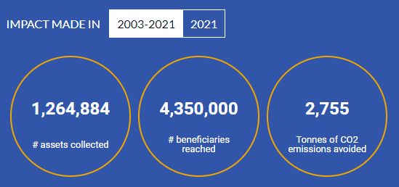
Case Study: Close the Gap
Close the Gap is an international social enterprise that aims to bridge the digital divide by offering
high-quality, pre-owned IT devices donated by European companies to educational, medical and social projects in developing and emerging countries.

Slide 64
Case Study: Close the Gap
Close the Gap believes in self-sufficiency, the organization sustains itself through partnership with big European company and through the second hand digital market.
Not every hardware recovered suits the social mission of Close the Gap, therefore after the reconditioning of the product, the organization sell it and succeeds to make profits.

Slide 65
Case Study: Close the Gap
Marnick Vanlee underlined how, despite being a no profit company, Close the Gap doesn’t give away the hardware for free.
“We deliberately ask contribution from the partner we support in Africa, we don’t believe in giving anything for free, you should give people a sense of ownership as it brings better results for the project. Only someone who is seriously interested and have the necessary condition to use the hardware will effectively use the product.”

Slide 66
Case Study: Close the Gap
Close the Gap only has five employees in Belgium, even being such a small no-profit company, it doesn’t rely on external funds or charity.
The enterprise, as we showed, is self-sufficient and capable of growth independently.

Slide 67
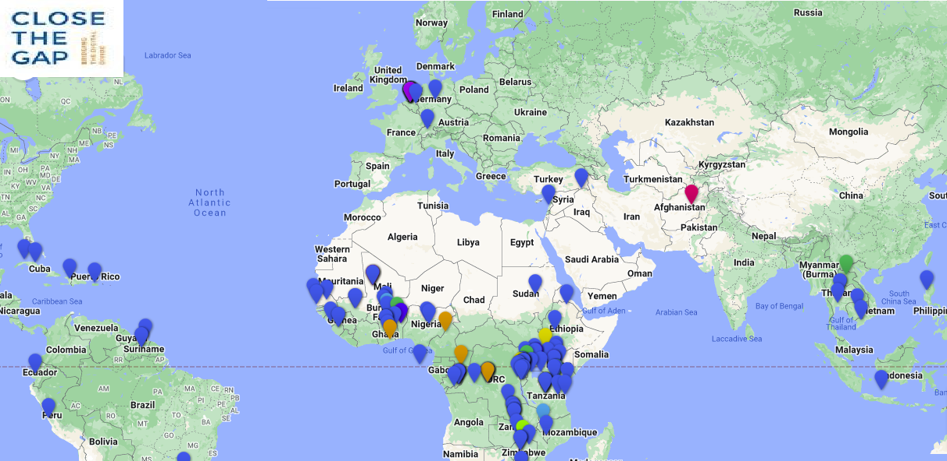
Case Study: Close the Gap
Close the gap has a large number of partners, that help in every aspect of the business from accounting to the practical matters.
Close the Gap is now a group of companies, the initial business model took a lot of development, despite being not oriented to profit the good business administration made possible a global expansion.

Slide 68
Case Study: Close the Gap
Close the Gap is a global company. In Belgium Close the Gap is a social enterprise but to be easily recognized globally it is as well registered as B-Corp.
“Being a B-Corp is very useful: in some countries normal enterprise activities are limited by law. Being a regular company registered as B-Corp allows Close the Gap to pursue its goal without any limitations.”

Slide 69
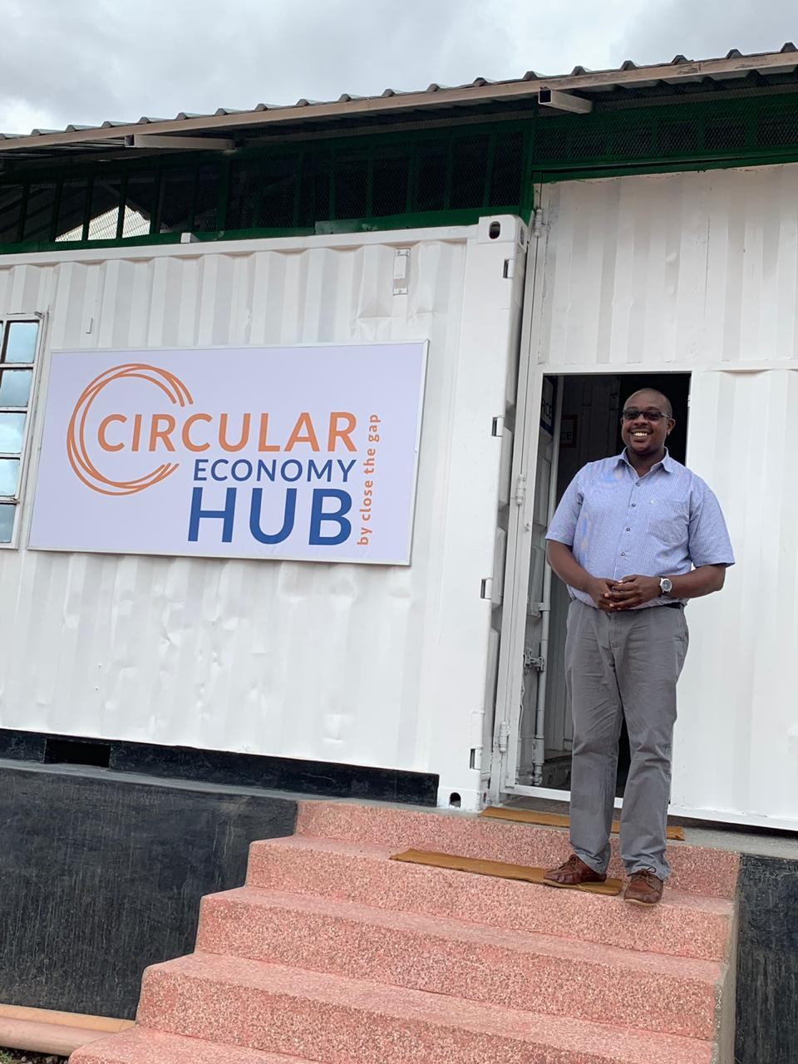
Case Study: Close the Gap
PROJECT CYCLE: From pick-up to recycling
Collection at donor company
Refurbishment of ICT equipment
Project selection
Transport equipment to project
Installation, maintenance, and trainings
Software & expertise
Follow-up and evaluation
Pick-up and recycling of end-of-life equipment

Slide 70
Case Study: Close the Gap
Close the Gap is the perfect example of a good and selfless idea that led to a sustainable social enterprise.
In over 20 years of activity Close the Gap helped countless people and set a bright example of sustainable business model.
Marnick Vanlee explained how being motivated by the desire to help the less fortunate don’t have to lead exclusively to charity foundation or unprofitable business. Close the
Gap demonstrated that also helping can be a
Business.

Slide 71
Key take-away points
The main objective of a social enterprise is to make social impact rather than profit
Every country has its own legislation, and culture, it is crucial to know the contest where you want to build your company in order to have success
A strong network is a key factor for social enterprises, which are considered a multi-stakeholder organization, this leads to create economic and social value.

Slide 72
Reflection/ Self-assessment
1) Is the objective of a social enterprise to make a profit?
2) Does a company that wants to be a B-Corp have to be non-profit?
3) Which country does not have a definition of social enterprise in its legislation?

Slide 73
Reflection/ Self-assessment
4) Are social enterprises usually considered multi-stakeholder organisations?
5) Is marketing less important for social enterprises than for normal enterprises?
6) Is the purpose of social impact measurement both internal and external?

Slide 74
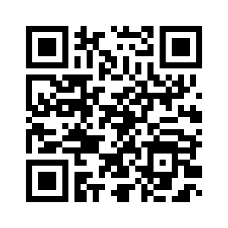
Thanks!
https://www.beyond-capital.eu/
Please keep this slide for attribution
www.cbe.be
Please, fill out this quick assessment to help us improve the module!

